Slide 1
Chapter 2: Security Standards and Frameworks for SOC​

Slide 2
Learning Outcomes
By the end of this topic, students should be able to:
Explain the purpose of security standards and frameworks.
Distinguish between policies, procedures, processes, and controls.
Describe the role of ISO/IEC 27001 and ISMS.
Explain the NIST Cybersecurity Framework (CSF).
Describe NIST SP 800-53 and its control families.
Explain the purpose of SOC 2.
Explain how MITRE ATT&CK supports SOC operations.
Explain how standards and frameworks can work together in a SOC.

Slide 3
Why Do SOCs Need Standards and Frameworks?

Slide 4
Security Standard vs Security Framework ​
Aspect | Security Standards | Security Frameworks
Definition | Formal, published requirements, specifications, or criteria that organizations can use to establish or demonstrate conformity. | Structured approaches, models, or sets of practices that help organizations manage, assess, and improve cybersecurity risk.
Main purpose | Establish defined requirements or criteria for security and, in some cases, support conformity or assessment. | Provide a common structure and guidance for identifying, managing, prioritizing, and communicating cybersecurity risks.
Level of flexibility | Generally more specific and prescriptive, depending on the standard. | Generally more flexible and adaptable to an organization's size, sector, risk profile, and objectives.
Typical focus | Requirements, controls, specifications, or assessment criteria. | Risk management, security outcomes, practices, implementation guidance, and organizational improvement.
Examples | ISO/IEC 27001 – requirements for an Information Security Management System (ISMS); PCI DSS – technical and operational requirements for protecting payment account data. (ISO) | NIST CSF 2.0 – cybersecurity risk-management framework; CIS Controls – prioritized cybersecurity safeguards; MITRE ATT&CK – adversary tactics and techniques knowledge base used for threat-informed defense. (NIST CSRC)
Example of application | An organization may implement ISO/IEC 27001 requirements to establish and continually improve an ISMS. (ISO) | An organization may use NIST CSF 2.0 to understand, assess, prioritize, and communicate cybersecurity risk. (NIST CSRC)

Slide 5
Security Standard vs Security Framework ​
Security Resource | Classification in the Chapter | Main Role | Main Focus
ISO/IEC 27001 | Security Standard | Establishes an Information Security Management System (ISMS) | Information security governance, risk management, policies, processes and controls
SOC 2 | Assurance / Reporting Framework | Demonstrates and reports on the effectiveness of controls | Security, availability, processing integrity, confidentiality and privacy
PCI DSS | Security Standard | Establishes security requirements for organizations handling payment-card data | Protection of payment-card information
NIST Cybersecurity Framework (CSF) | Cybersecurity Framework | Provides a structured approach to managing cybersecurity risk | Identify, Protect, Detect, Respond, Recover
NIST SP 800-53 | Security & Privacy Control Catalog | Provides detailed security and privacy controls | Access control, audit, incident response, configuration, risk assessment, etc.
MITRE ATT&CK | Threat-Informed Security Framework / Knowledge Base | Describes adversary behavior | Tactics, techniques and procedures (TTPs)
ISMS | Management Framework/System | Provides the organizational structure for managing information security | Policies, procedures, processes, controls and continuous improvement

Slide 6
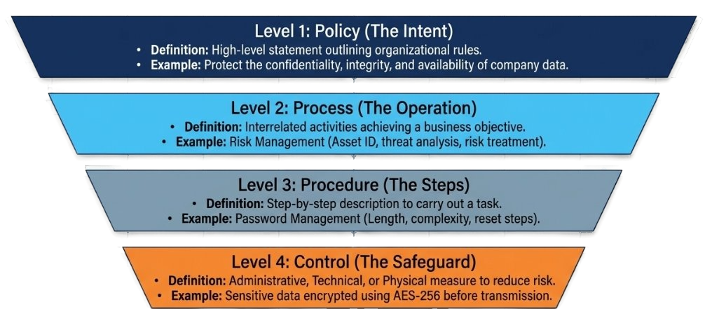
Security Governance: Policies, Procedures, and Controls

Slide 7
Policies
Student Self Study
A policy is a high-level statement that outlines an organization’s intentions, principles, and rules regarding a specific area of operation.
In ISMS Context: Information security policies define the organization's commitment to protecting information assets and set the tone for security practices.
Example:
  “All employees must protect the confidentiality, integrity, and availability of company data and follow approved security procedures.”

Slide 8
Procedures
Student Self Study
A procedure is a detailed, step-by-step description of how to carry out a specific task or activity in accordance with a policy.
In ISMS Context: Procedures translate policies into actionable steps that employees can follow to ensure compliance and consistency.
Example:
  A Password Management Procedure may include:
    Minimum password length
    Complexity requirements
    Frequency of password changes
    How to reset a forgotten password

Slide 9
Processes
Student Self Study
A process is a series of interrelated activities or tasks that collectively achieve a specific business objective.
In ISMS Context: Processes are broader than procedures and often involve multiple departments or systems working together to manage security risks.
Example:
  The Risk Management Process may include:
    Asset identification
    Threat and vulnerability analysis
    Risk evaluation
    Risk treatment and monitoring

Slide 10
Controls
Student Self Study
A control is a measure or safeguard implemented to reduce or manage risk to an acceptable level.
In ISMS Context: Controls are selected based on risk assessments and are used to protect information assets from threats.
Types of Controls:
  Administrative: Policies, training, procedures
  Technical: Firewalls, encryption, access controls
  Physical: Locks, surveillance, secure areas
Example:
  “All sensitive data must be encrypted using AES-256 before transmission over public networks.”

Slide 11
Security Governance: Policies, Procedures, and Controls
Security concept | What it means in this scenario
Policy | Account and authentication policy: Employees must protect their accounts, use approved authentication methods, and report suspicious authentication activity.
Procedure | Account compromise procedure: Verify the user's identity → suspend the affected account → investigate authentication logs → reset credentials → re-enroll/verify MFA → restore access.
Process | Identity and Access Management (IAM) process: User creation → authentication → access management → monitoring → password/MFA changes → periodic review → account termination.
Controls | MFA, access controls, authentication logging, privileged-access controls, password-reset controls, and monitoring.
SOC | Monitor → Detect → Investigate → Contain → Recover → Review. The SOC examines suspicious password/MFA changes and authentication activity and initiates the appropriate response.
Case: Okta Support Account Compromise — 2022
In January 2022, an attacker gained access to an Okta support employee's account. Cloudflare, which used Okta for internal authentication, investigated the incident and examined authentication, password-reset, and MFA-related events

Slide 12
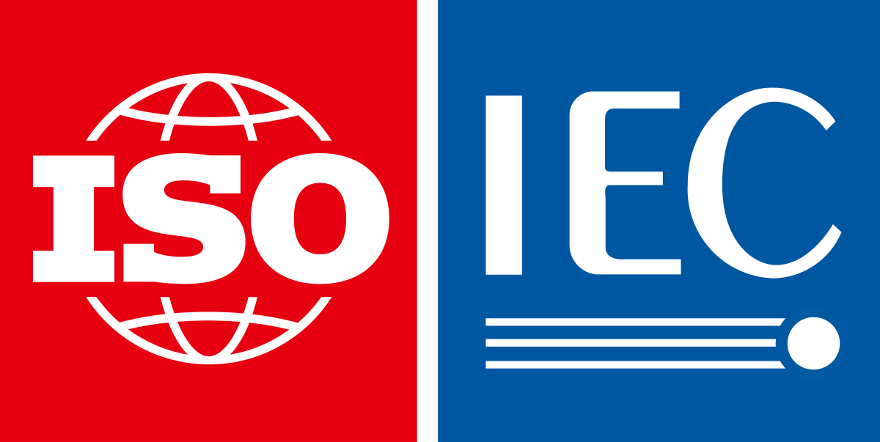
ISO/IEC 27001
international standard for information security management.
Purpose
Scope
Risk-based approach
ISMS
Annex A controls

Slide 13
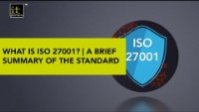
https://www.itgovernance.co.uk/iso27001
https://youtu.be/x792wXSeAhA

Slide 14
ISO/IEC 27001
Purpose:
  ISO/IEC 27001 is designed to help organizations protect their information assets systematically and cost-effectively, through the adoption of an Information Security Management System (ISMS).
Why is it needed?
  Cyber threats, data breaches, and regulatory requirements are increasing.
  Organizations need a structured way to manage risks to their information.
  ISO/IEC 27001 provides internationally recognized best practices for information security.

Slide 15
ISO/IEC 27001
Scope:
  Who can use it? Any organization, regardless of size, industry, or geography.
  What does it cover? All types of information: digital (databases, emails), physical (paper records), intellectual property, and even spoken information.
  How is scope defined? Each organization defines its own ISMS scope, which could be the whole company or just a specific department, process, or location. The scope is documented and justified in the ISMS documentation.
Example:
  A hospital may apply ISO/IEC 27001 to its patient records management system, while a software company may apply it to its entire IT infrastructure.

Slide 16
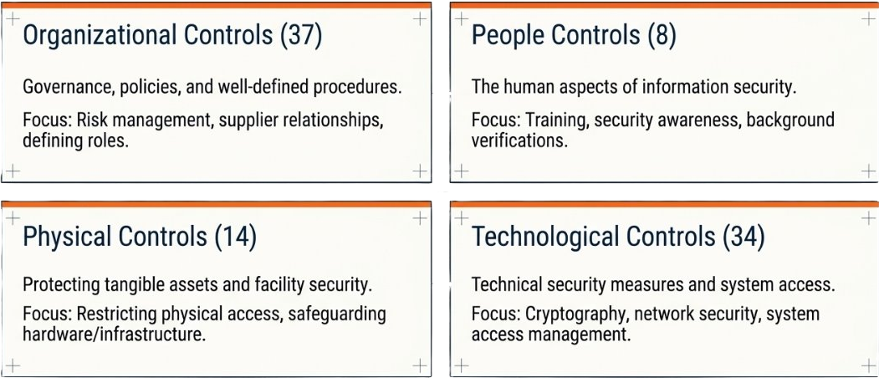
ISO/IEC 27001Annex A Controls:
  Annex A provides a catalog of 93 controls (as of the 2022 version), grouped into: four themes:

Slide 17
Information Security Management System (ISMS)
ISMS is a structured framework of policies, procedures, processes, and controls designed to systematically manage and protect an organization’s information assets.
The primary goal of an ISMS is to ensure the confidentiality, integrity, and availability of information by applying a risk management approach.
It helps organizations identify potential threats, assess vulnerabilities, and implement appropriate safeguards to mitigate risks.
Key Characteristics of ISMS as a Framework:
  Based on ISO/IEC 27001: The international standard for ISMS.
  Risk-Based Approach: Identifies and mitigates risks to information security.
  Continuous Improvement: Uses the PDCA (Plan-Do-Check-Act) cycle.
  Scalable and Flexible: Can be adapted to different types of organizations, including universities.

Slide 18
The ISMS Lifecycle: Plan-Do-Check-Act (PDCA)
The PDCA cycle ensures continuous improvement of the ISMS:
Plan:
Define ISMS policies, objectives, processes, and procedures.
Conduct risk assessments and select controls.
Do:
Implement the planned processes and controls.
Train staff and raise awareness.
Check:
Monitor and measure processes and controls.
Conduct internal audits and management reviews.
Act:
Take corrective and preventive actions based on audit findings and performance data.
Update policies and controls as needed.

Slide 19
Use in a SOC
Provides guidelines and controls for information security.
Ensures the SOC is aligned with international best practices.
Helps define policies, procedures, and risk management for SOC operations.
Supports compliance and audit readiness.
Guides SOC teams on incident response processes (e.g., ISO/IEC 27035).
Establishes a continuous improvement cycle for monitoring, detection, and response.

Slide 20
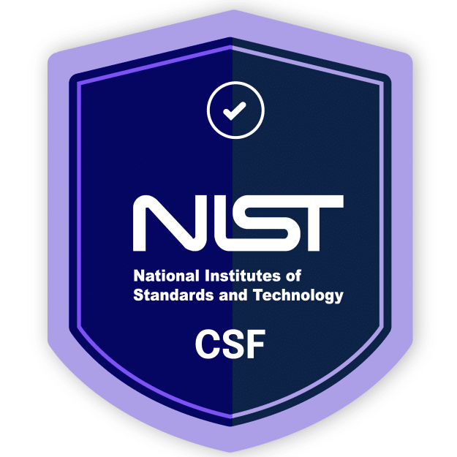
Cybersecurity risk management
NIST Cybersecurity Framework (CSF)
Catalog of privacy and security controls for information systems​

Slide 21
NIST Cybersecurity Framework
The NIST Cybersecurity Framework (NIST CSF) is a widely adopted set of guidelines and best practices designed to help organizations manage and reduce cybersecurity risk.
Developed by the U.S. National Institute of Standards and Technology (NIST), it provides a flexible, repeatable, and cost-effective approach for organizations of all sizes and industries.

Slide 22
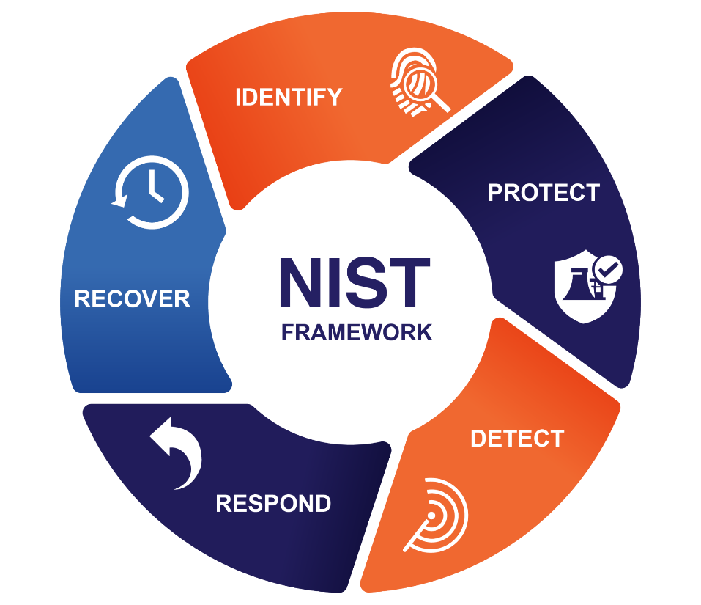
Core Components of the NIST CSF
Identify:
Protect:
Detect:
Respond:
Recover:
Understand your environment to manage cybersecurity risk.
Implement safeguards to ensure delivery of critical services.
Identify the occurrence of a cybersecurity event.
Take action regarding a detected cybersecurity incident.
Restore capabilities or services impaired by a cybersecurity incident.

Slide 23

Core Components of the NIST CSF
Function | Example Activities
Identify | Asset management, risk assessment
Protect | Access control, data security, awareness training
Detect | Anomaly detection, continuous monitoring
Respond | Incident response planning, communications
Recover | Backup, disaster recovery, improvements

Slide 24
Why NIST CSF is important in SOC
Provides a Structured Approach
  The NIST CSF gives SOC teams a clear, organized way to manage cybersecurity risks.
  It breaks down security activities into the five core functions (Identify, Protect, Detect, Respond, Recover), which map directly to SOC responsibilities.
Enhances Threat Detection and Response
  The Detect and Respond functions are central to SOC operations.
  The framework helps SOCs develop processes for monitoring, analyzing, and responding to security incidents efficiently.
Supports Continuous Improvement
  The NIST CSF encourages regular assessment and improvement of security processes.
  SOCs can use the framework to identify gaps, measure maturity, and prioritize improvements.
Facilitates Communication
  The framework uses common language, making it easier for SOC analysts to communicate with management, auditors, and other departments.
  This helps align security operations with business objectives.
Compliance and Best Practices
  Many regulations and standards reference or align with the NIST CSF.
  Using the framework helps SOCs demonstrate compliance and follow industry best practices.

Slide 25
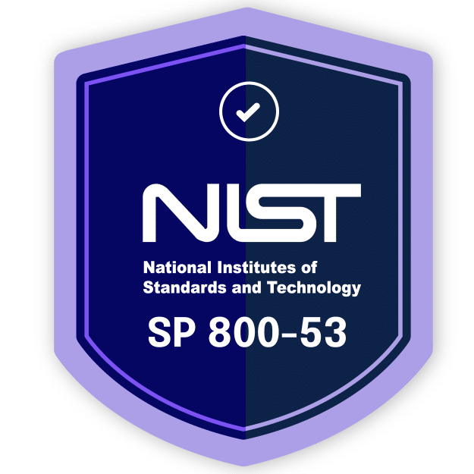
NIST SP 800-53​
Detailed security controls
Catalog of privacy and security controls for information systems

Slide 26
NIST SP 800-53​
It is a collection of specific safeguarding measures that can be used to protect an organization’s operations and data and the privacy of individuals.
Applies to both IT systems and operational technology (OT) environments.
Purpose
  To provide a standardized set of security and privacy controls for information systems.
  To help organizations manage risk and protect the confidentiality, integrity, and availability of information.

Slide 27
Why NIST SP 800-53 is required in SOC?
Provides a catalog of security controls (access control, incident response, monitoring, audit logging, etc.) that a SOC can map directly to its daily operations.
Defines requirements for audit logs, continuous monitoring, and intrusion detection that SOCs must implement.
Ensures the SOC has proper visibility into systems, networks, and user activities for threat detection.
  Example: Controls like AU-2 (Audit Events) and AU-6 (Audit Review, Analysis, and Reporting) require organizations to collect detailed logs (system events, errors, configuration changes).
Maps to the Incident Response controls (IR family) in NIST SP 800-53, which guide SOC teams on:
  Detecting and analyzing incidents
  Documenting and reporting incidents
  Coordinating with stakeholders
Many organizations (especially government and regulated industries) require alignment with NIST 800-53. As it will provide a baseline for compliance auditing and to ensure their monitoring activities cover all required control families.

Slide 28
NIST SP 800-53​
Examples include:
AC – Access Control: Who can access systems and data, and under what conditions.
AU – Audit and Accountability: Logging, monitoring, and traceability.
CM – Configuration Management: Secure baseline configurations, change control.
CP – Contingency Planning: Backup, recovery, and continuity.
IR – Incident Response: Preparation, detection, analysis, and recovery.
RA – Risk Assessment: Identifying and evaluating risks.
SC – System and Communications Protection: Encryption, boundary defense, network security.
SI – System and Information Integrity: Patch management, malware defense.
PL – Planning: Security plans, strategy, documentation.
PM – Program Management: Enterprise-wide governance.
PT – Privacy: Controls for handling personally identifiable information (PII).
NIST SP 800-53 lists 20 families of controls that provide operational and technical safeguards to ensure the privacy, integrity, and security of information systems.

Slide 29
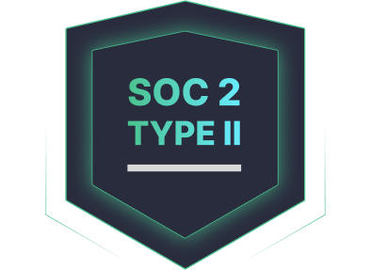
Service Organization
Controls (SOC 2)
Assurance and reporting

Slide 30
SOC 2: Service Organization Controls
Purpose:
  SOC 2 is designed to help service organizations demonstrate that they manage customer data securely and in accordance with best practices.
  It is especially relevant for technology and cloud computing companies that store or process customer information.
Scope:
  Focuses on non-financial reporting controls related to security, availability, processing integrity, confidentiality, and privacy of data.

Slide 31
Trust Services Criteria (TSC)
SOC 2 reports are structured around five Trust Services Criteria:
Security:
Protection of system resources against unauthorized access (the only mandatory criterion for all SOC 2 reports).
Availability:
The system is available for operation and use as committed or agreed.
Processing Integrity:
System processing is complete, valid, accurate, timely, and authorized.
Confidentiality:
Information designated as confidential is protected as committed or agreed.
Privacy:
Personal information is collected, used, retained, disclosed, and disposed of in conformity with the commitments in the entity’s privacy notice.

Slide 32
TSC Example (Application in University)
Trust Services Criteria (TSC) | Application in University
Security (Mandatory) | Firewalls, access controls, and intrusion detection systems protect student data.
Availability | Systems are hosted on redundant cloud infrastructure with 99.9% uptime SLAs.
Processing Integrity | Grade submissions and transcript generation are validated for accuracy and timeliness.
Confidentiality | Role-based access ensures only authorized staff can view sensitive student records.
Privacy | Student data is collected and processed in accordance with FERPA and GDPR (if applicable).

Slide 33
Types of SOC 2 Reports (Type I vs Type II)
SOC 2 Type I:
  Describes a service organization’s systems and whether the design of specified controls meets the relevant trust criteria at a specific point in time.
  Focus: Design of controls.
SOC 2 Type II:
  Includes everything in Type I, but also details the operating effectiveness of those controls over a defined period (usually 3–12 months).
  Focus: Design and operational effectiveness of controls.

Slide 34
Types of SOC 2 Reports (Type I vs Type II)
Type I | Type II
Design of controls | Design + operating effectiveness
Specific point in time | Defined period
Are controls suitably designed? | Do controls operate effectively over time?
Type II is generally more valuable to customers, as it demonstrates that controls are not only designed properly but also function effectively over time.

Slide 35
Use in a SOC
Ensures the SOC demonstrates operational effectiveness of its security controls.
Useful for service providers (cloud, SaaS, data centers) to show customers and auditors that their environment is trustworthy.
Aligns SOC monitoring, logging, and reporting with evidence required for SOC 2 audits.
Drives SOC activities to cover data confidentiality, uptime, and integrity.
Helps SOC provide assurance reports to clients about security posture.

Slide 36
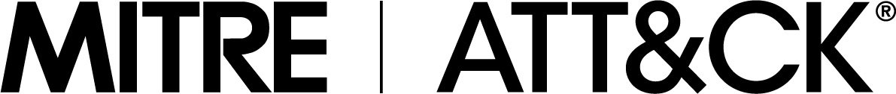
MITRE ATT&CK framework
A globally recognized knowledge base that describes the tactics, techniques, and procedures (TTPs) used by cyber adversaries.

Slide 37
MITRE ATT&CK: Tactics, Techniques and Procedures
ATT&CK stands for Adversarial Tactics, Techniques, and Common Knowledge.
Developed and maintained by MITRE Corporation
It provides a structured framework that security professionals, researchers, and SOC teams use to understand attacker behavior.

Slide 38
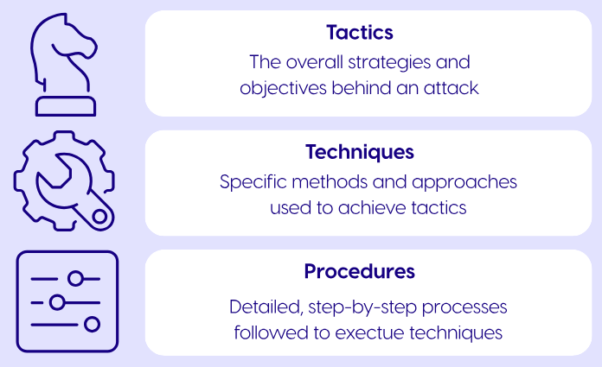
MITRE ATT&CK: Tactics, Techniques and Procedures
Tactics (the “why”)
  The adversary’s objectives (e.g., persistence, privilege escalation, exfiltration).
Techniques (the “how”)
  The methods attackers use to achieve a tactic (e.g., phishing, credential dumping).
Procedures (the “implementation”)
  Specific, real-world examples of how adversaries use techniques.
Source: cymulate.com

Slide 39
Uses of MITRE ATT&CK
Threat Intelligence → Map real-world campaigns.
Red Teaming → Simulate adversaries based on known techniques.
Blue Teaming → Detect, defend, and hunt threats.
SOC Maturity Assessment → Identify detection and defense gaps.
Framework Mapping → Link with NIST, ISO, or Cyber Kill Chain.

Slide 40
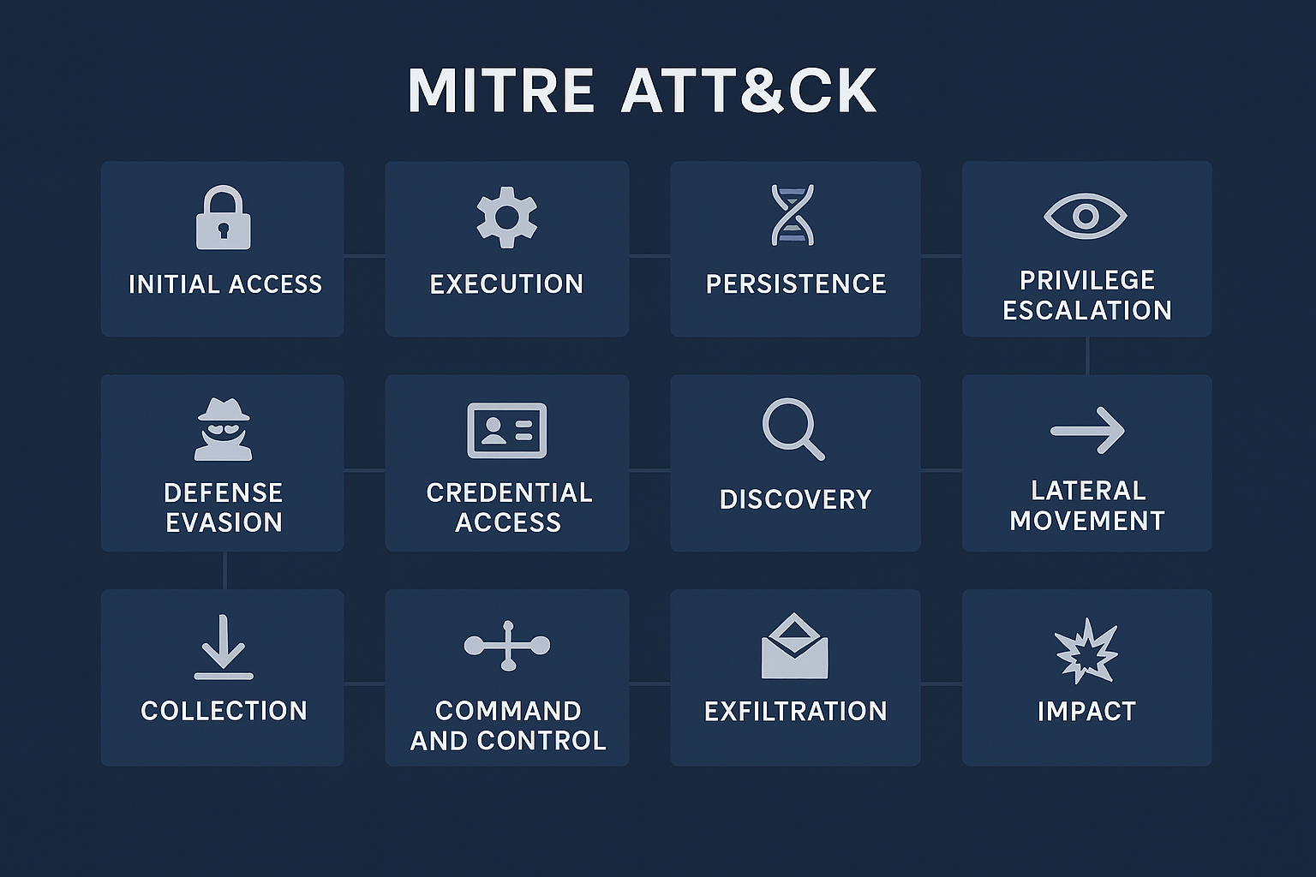
Tactics
High-level objectives that describe why an attacker performs an action.
In the ATT&CK Matrix, tactics are arranged as columns, showing the progression of an attack from initial access to impact.
They help security teams understand the intent behind malicious activity, rather than just the method used.

Slide 41
Tactics
Tactic | Description | Examples
Initial Access | How adversaries gain entry into a network or system. | Phishing, Drive-by Compromise, Exploit Public-Facing Application
Execution | Running malicious code on a local or remote system. | PowerShell, Command-Line Interface, Malicious Scripts
Persistence | Maintaining access across reboots or credential changes. | Registry Run Keys, Scheduled Tasks, Account Manipulation
Privilege Escalation | Gaining higher-level permissions or access. | Exploiting Vulnerabilities, Token Manipulation, Sudo/Su Abuse
Defense Evasion | Avoiding detection or bypassing security mechanisms. | Obfuscation, Disabling Security Tools, File Deletion
Credential Access | Stealing credentials like usernames and passwords. | Keylogging, Credential Dumping, Brute Force
Discovery | Learning about the environment and internal systems. | Network Scanning, System Information Discovery, Account Discovery
Lateral Movement | Moving through the network to access other systems. | Remote Desktop Protocol (RDP), Pass the Hash, SMB/Windows Admin Shares
Collection | Gathering data of interest for exfiltration. | Clipboard Capture, Screen Capture, Audio Capture
Command and Control | Communicating with compromised systems to issue commands. | C2 Channels, Web Protocols, Remote Access Tools
Exfiltration | Stealing and transferring data out of the network. | Exfiltration Over HTTPS, Scheduled Transfer, Cloud Storage Upload
Impact | Manipulating, interrupting, or destroying systems and data. | Data Wiping, Defacement, Ransomware, Service Stop

Slide 42
Technique
A Technique is a behavior or method that an attacker uses to accomplish a tactical goal.
Techniques are observable in system logs, network traffic, or endpoints, making them useful for detection and threat hunting.
Techniques often have sub-techniques, which are more granular, describing specific variations or implementations of the main technique.

Slide 43
Tactic | Technique | Description
Initial Access | Phishing (T1566) | Sending deceptive emails to trick users into revealing credentials or downloading malware.
Initial Access | Drive-by Compromise (T1189) | Gaining access when a user visits a compromised website.
Initial Access | Exploit Public-Facing Application (T1190) | Exploiting vulnerabilities in internet-facing applications to gain access.
Execution | Command and Scripting Interpreter (T1059) | Running scripts or commands on a system (e.g., PowerShell, Bash).
Execution | PowerShell (T1059.001) | Using PowerShell to execute malicious commands or scripts.
Execution | Exploitation for Client Execution (T1203) | Exploiting software vulnerabilities to execute code on a target system.
Persistence | Registry Run Keys/Startup Folder (T1547.001) | Adding programs to run automatically at startup via registry or startup folder.
Persistence | Scheduled Task/Job (T1053) | Creating scheduled tasks to maintain persistence.
Persistence | Account Manipulation (T1098) | Creating or modifying accounts to maintain access.
Privilege Escalation | Exploitation for Privilege Escalation (T1068) | Exploiting vulnerabilities to gain higher privileges.
Privilege Escalation | Sudo and Sudo Caching (T1548.003) | Abusing sudo permissions on Unix systems to escalate privileges.
Privilege Escalation | Token Manipulation (T1134) | Abusing access tokens to gain elevated permissions.

Slide 44
Tactic | Technique | Description
Defense Evasion | Obfuscated Files or Information (T1027) | Hiding code or data to avoid detection.
Defense Evasion | Indicator Removal on Host (T1070) | Deleting logs or artifacts to cover tracks.
Defense Evasion | Disable or Modify Tools (T1562) | Disabling security software or modifying its configuration.
Credential Access | Credential Dumping (T1003) | Extracting credentials from operating system memory.
Credential Access | Brute Force (T1110) | Attempting many passwords or keys to gain access.
Credential Access | Input Capture (T1056) | Capturing user input, such as keystrokes, to steal credentials.
Discovery | System Information Discovery (T1082) | Gathering information about the operating system and hardware.
Discovery | Network Service Scanning (T1046) | Scanning for open ports and services on the network.
Discovery | Account Discovery (T1087) | Identifying user and group accounts on systems.
Lateral Movement | Remote Services (T1021) | Using protocols like RDP or SMB to move between systems.
Lateral Movement | Pass the Hash (T1558.001) | Using stolen password hashes to authenticate as a user.
Lateral Movement | SMB/Windows Admin Shares (T1077) | Using Windows shares to move laterally in a network.

Slide 45
Tactic | Technique | Description
Collection | Clipboard Data (T1115) | Collecting data copied to the clipboard.
Collection | Screen Capture (T1113) | Taking screenshots of the user’s desktop.
Collection | Audio Capture (T1123) | Recording audio from a system’s microphone.
Command and Control | Application Layer Protocol (T1071) | Using common protocols (HTTP, HTTPS, DNS) for C2 communication.
Command and Control | Web Protocols (T1071.001) | Using web traffic to communicate with compromised systems.
Command and Control | Remote Access Tools (T1219) | Using remote access software for C2.
Exfiltration | Exfiltration Over Web Service (T1048.003) | Sending stolen data over web services (e.g., cloud storage).
Exfiltration | Scheduled Transfer (T1020) | Exfiltrating data at scheduled intervals.
Exfiltration | Cloud Storage Upload (T1537) | Uploading stolen data to cloud storage services.
Impact | Data Destruction (T1485) | Deleting or corrupting data to cause damage.
Impact | Defacement (T1491) | Altering content on websites or systems.
Impact | Resource Hijacking (T1496) | Using system resources for unauthorized purposes (e.g., cryptomining).

Slide 46
Procedures
Procedures are concrete examples of how adversaries implement techniques.
While tactics are the goals and techniques are the methods, procedures show exactly how attackers carry out an action in real scenarios.
Procedures reference actual attacks observed in the wild. They may include command lines, malware behavior, or system modifications. Often linked to threat actors (e.g., APT29, APT32 and APT41). This helps analysts correlate techniques with known actors.
Understanding procedures helps SOC teams write SIEM rules, detection logic, and response playbooks.
  Example: If a procedure uses schtasks to schedule malware, a SOC analyst can monitor for unusual scheduled tasks.
MITRE continuously adds new procedures as new attacks are observed, ensuring the knowledge base reflects current real-world threats.

Slide 47
Threat Actor ➔ APT
An APT (Advanced Persistent Threat) refers to a highly skilled, well-funded, and organized cyberattack group that targets specific organizations or nations over an extended period.
APT1 (Comment Crew / Unit 61398 – China)
  Targets: Aerospace, telecommunications, and manufacturing.
  Motivation: Corporate espionage for economic and strategic advantage.
  Tactics: Spear-phishing, malware, and remote access Trojans (RATs).
APT28 (Fancy Bear – Russia)
  Targets: Political organizations, military, media.
  Motivation: Political influence and intelligence gathering.
  Tactics: Phishing emails, zero-day exploits, credential harvesting.
  Notable Operation: 2016 US elections interference.
APT29 (Cozy Bear – Russia)
  Targets: Government agencies, think tanks, healthcare.
  Motivation: Espionage and strategic intelligence.
  Tactics: Sophisticated malware, supply chain attacks, stealthy lateral movement.
  Notable Operation: SolarWinds supply chain attack (2020).
APT10 (Stone Panda / Menu
  Pass – China)Targets: Global corporations, managed IT service providers.
  Motivation: Corporate espionage and intellectual property theft.
  Tactics: Cloud environment exploitation, phishing, and custom malware.
APT32 (OceanLotus – Vietnam)
  Targets: Foreign governments, dissidents, multinational corporations.
  Motivation: Political and economic intelligence.
  Tactics: Spear-phishing, watering-hole attacks, malware implants.
APT41 (Barium – China)
  Targets: Healthcare, technology, and video game companies.
  Motivation: Dual-purpose: cyber espionage and financially motivated attacks.
  Tactics: Supply chain attacks, ransomware deployment, malware campaigns.

Slide 48
Examples
Tactic: Persistence
  Technique: “Create Account” (method: add a new user to maintain access)
    Procedure: APT29 creates a local admin account named ‘Updater’ on Windows systems using PowerShell commands to maintain persistence.
Tactic: Initial Access
  Technique: Phishing - Spearphishing Attachment
    Procedure: In 2022, APT41 delivered malware-laden Excel files via email to government contractors. The Excel macro executed a PowerShell script to download additional malware and create persistence.

Slide 49
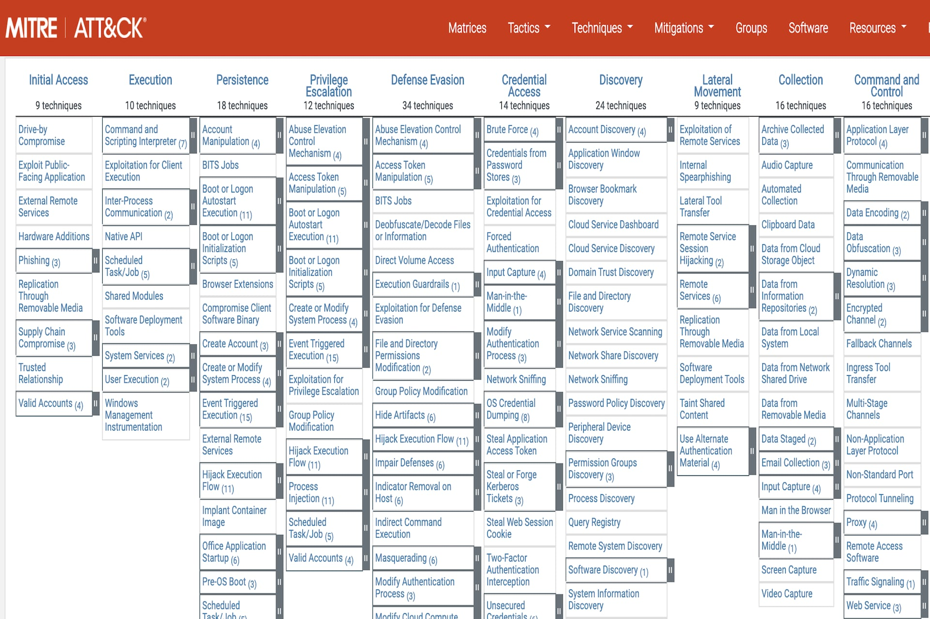

Slide 50
References
Landoll, Douglas J. Information Security Policies, Procedures, and Standards : A Practitioner’s Reference. Boca Raton, Crc Press, Taylor & Francis Group, 2016.
Rafaels, Raymond. Guide to Understanding Security Controls. Amazon Digital Services, 10 May 2019.
“SOC 1, 2, 3 Compliance: Understanding & Achieving SOC Compliance | Splunk.” Splunk, 2025, www.splunk.com/en_us/blog/learn/soc-compliance.html.
Williams, Barry L. Information Security Policy Development for Compliance : ISO/IEC 27001, NIST SP 800-53, HIPAA Standard, PCI DSS V2.0, and AUP V5.0. Boca Raton, Fl, Crc Press, Taylor & Francis Group, 2013.
“Aligning Your Security Program to NIST SP 800-53.” Hyperproof, hyperproof.io/nist-800-53/.

